Slide 1
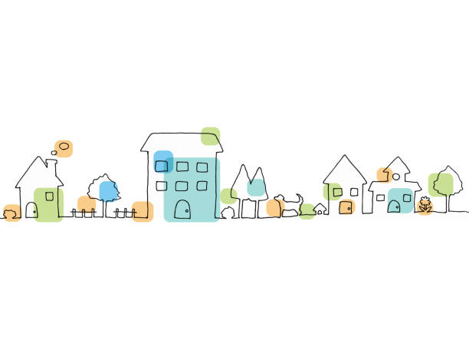
Appendix: Deeper Dive into the Data

Slide 2
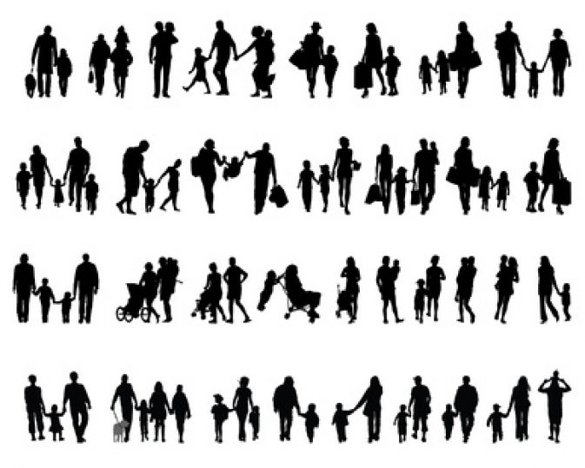
Who Is Underrepresented — and Why It Matters
The 2025 survey did not fully capture:
• Plateau communities (very low participation from Dorrigo & surrounds)
• Younger residents (under 35)
• CALD communities (2%)
• Highly precarious households (including people in crisis housing)
First Nations participation:
• 4% of respondents — proportionate to the Shire population (~4.3%)
• However, absolute numbers were small and require deeper engagement
Why This Matters
• Some of the most affected groups may still be undercounted
• Online surveys do not reach everyone equally
• Targeted, culturally appropriate engagement is underway (see next slide)
• Future assessments must actively include harder-to-reach voices

Slide 3
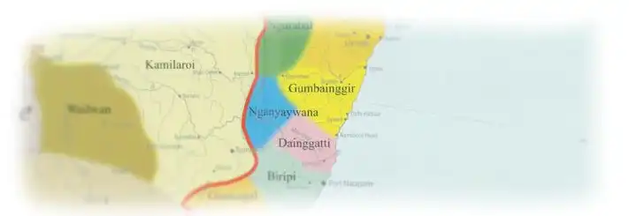
Gumbaynggirr Housing Consultation (2025)
In 2025, HMAG commissioned culturally grounded consultation on the housing needs of First Nations people in the Bellingen Shire.
Consultations were undertaken with:
• Gumbaynggirr community members
• Elders and families
• Bowraville & Nambucca Heads LALCs
• Aboriginal organisations and ACCOs
Key themes:
• Housing pressure is driving displacement from Country
• Hidden overcrowding and intergenerational stress
• Urgent need for Elders housing and youth pathways
• Strong readiness for Aboriginal-led housing solutions
• Alignment for partnership and land activation
Our commitment:
HMAG is committed to respectful partnership, cultural governance, and embedding Aboriginal housing pathways within our 10-year strategy.

Slide 4

Homelessness & Housing Precarity Consultation (2025)
In 2025, HMAG undertook dedicated consultation with:
• Neighbourhood Centres (Bellingen, Urunga, Dorrigo)
• Mission Australia outreach
• BRANCH Co-op & RFBI housing
• Local churches, food pantries & volunteer groups
• Showground and informal accommodation stakeholders
• Community members supporting rough sleepers
The consultation identified:
• Growing hidden homelessness
• Increasing older women living in cars
• Rough sleeping in dunes, river areas and showgrounds
• Severe gaps in crisis accommodation
• Frontline services stretched to capacity
Our commitment:
HMAG will continue working alongside frontline services, strengthening coordination, and advocating for structural housing responses that reduce homelessness in our Shire.

Slide 5
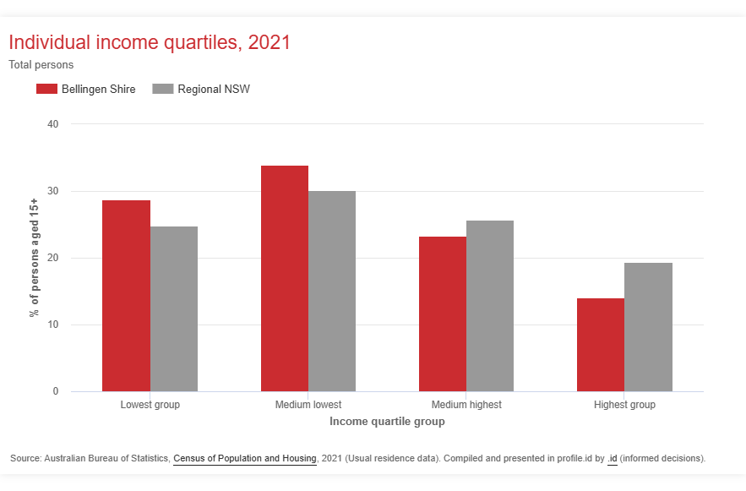
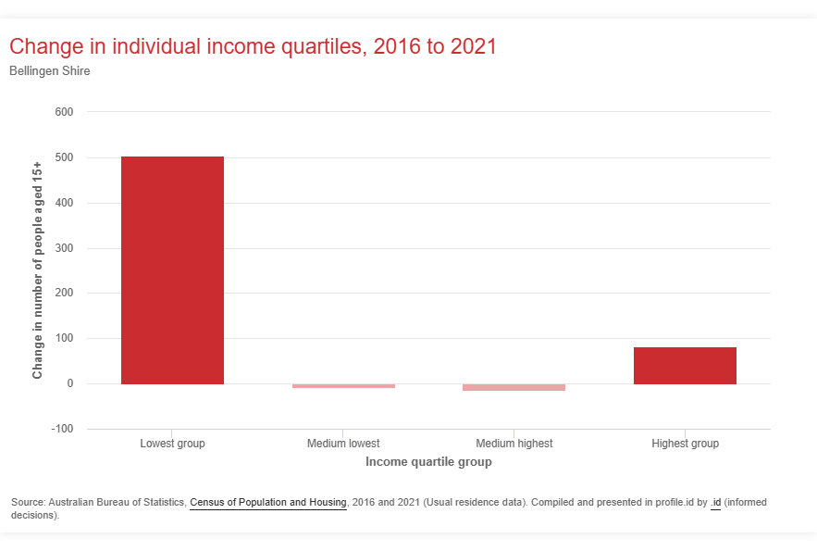
Individual Incomes
Quartile group ranges:
Lowest: $0 - $384 pw
Medium lowest: $385 - $813 pw
Medium highest: $814 - $1520 pw
Highest: $1521 and over pw
Notes:
Large increase in number in lowest group (+ 504)
62.6% are in the lowest 2 quartiles
INCOME & EMPLOYMENT
Notes:
Large increase in individuals in the lowest quartile - people earning less than $384pw.
62.6% of individuals are in the lowest two quartiles - people earning less than $814pw.

Slide 6
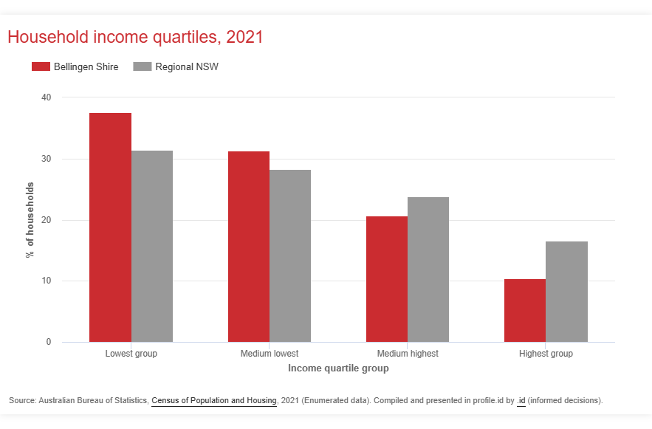
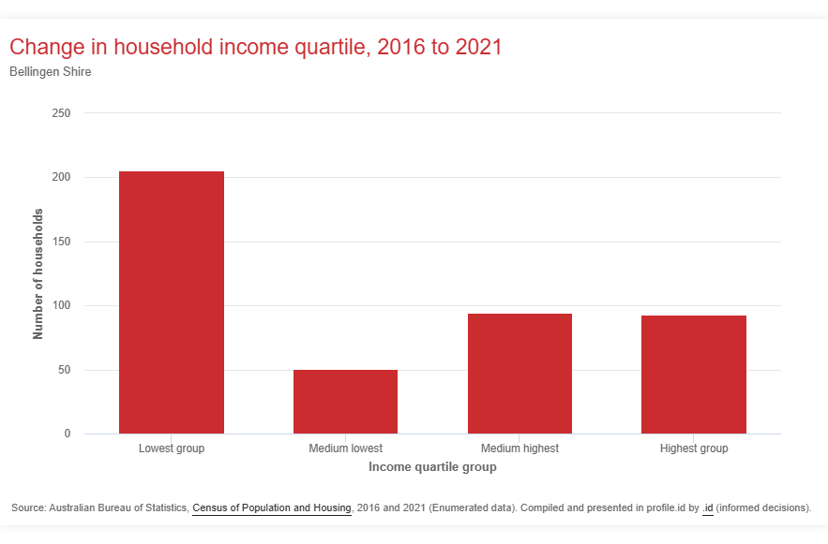
Household Incomes
Quartile group ranges:
Lowest: $0 - $886 pw
Medium lowest: $887 - $1824 pw
Medium highest: $1825 - $3134 pw
Highest: $3135 and over pw
Notes:
Increase in lowest group (+ 205)
30.9% households are low income (less than $800 pw) (Regional NSW average 26%)
INCOME & EMPLOYMENT
Notes:
Again, over-representation in lowest two quartiles and largest increase is in lowest group.
30.9% of households are low income (less than $800pw)
The poverty line for a family of two adults and two children is $1226 (October 2025), for single people, it is $584

Slide 7
Median Incomes
INDIVIDUALS
Bellingen Shire Individual Median Weekly Income: $613
NSW Individual Median Weekly Income: $813
$200 less or 24.6% less PER WEEK
Both individual and household median weekly incomes are significantly lower than NSW medians.
The poverty line for a couple with two children is $1226 (Oct 2025). The median household income is below the poverty line!
INCOME & EMPLOYMENT
HOUSEHOLDS
Bellingen Shire Household Median Weekly Income: $1197
NSW Household Median Weekly Income: $1829
$632 less or 34.5% less PER WEEK
Notes:
The poverty line is $584 a week for a single adult and $1,226 a week for a couple with two children. Note: Bellingen has high rate of lone person households and households with no children so this isn’t a straight-forward comparison.
Also seeing small but significant increase in people in top quartile - risk of stratification

Slide 8
Local workforce
Changes in Local Employment
Declining sectors
Health Care & Social Assistance −8.5%
Education & Training −4.1%
Arts & Recreation −9%
Transport, Postal & Warehousing −10.7%
Growing sector
Construction +15.5%
Key point:
Local employment patterns suggest a shift away from some service industries while construction activity has increased.
In 2016, 78% of local workers also lived in the region.
In 2021, 74.9% of local workers live in the region.
INCOME & EMPLOYMENT
Notes:
This is a rate to watch. Particularly given that the biggest reductions in local workforce are some of our biggest industries. Health Care & Social Assistance, Education & Training. And the Arts & Recreation - areas that the area in ‘known for’ is also declining.

Slide 9
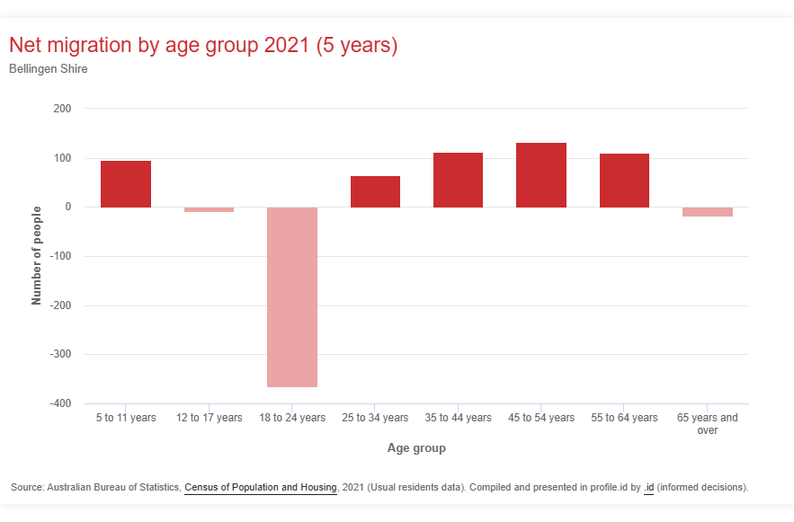
Migration by age
Migration trends show strong movement among mid-life and older residents.
Key points
Young adults (18–24 years) show significant net out-migration. (Net migration: −365)
The largest net migration gain was among people aged 45–54 years (+132).
The largest inflow of residents was in the 65 years and over age group (+386).
However, this same age group also recorded high out-migration (−403), indicating significant turnover among older residents.
These patterns suggest Bellingen Shire continues to attract mid-life and retirement-age residents, while many young adults are leaving the Shire.
MIGRATION & MOBILITY
Notes:
Increase in 45 - 54 years: Could be early retirees, mobile workers (Professional & Technical Services?) and families with children moving for lifestyle reasons (increase in 5-11 years as well as 45-54 years)
Usual to see drop in 18-24 year olds as they move for work, study and adventure but higher rates than other regions

Slide 10
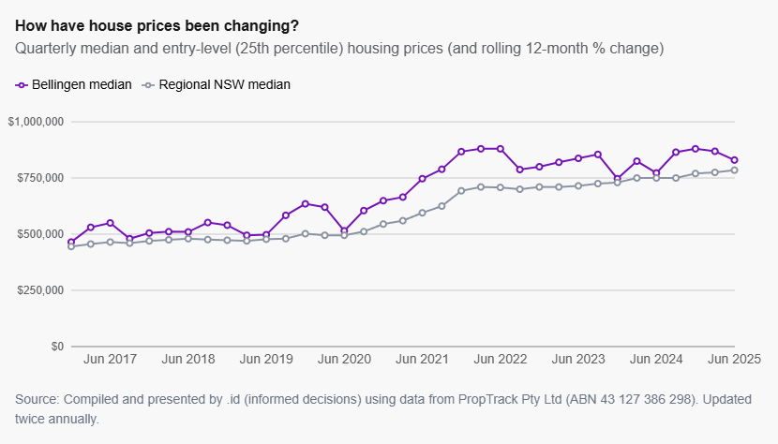
House Prices
The graph shows changes in entry-level housing prices over time.
Following steep COVID-era increases, prices are now moving more in line with regional NSW averages.
Despite this stabilisation, prices remain high relative to local incomes.
HOUSING COSTS
Source: Housing.id – Bellingen Shire Housing Monitor (ABS Census 2021).

Slide 11
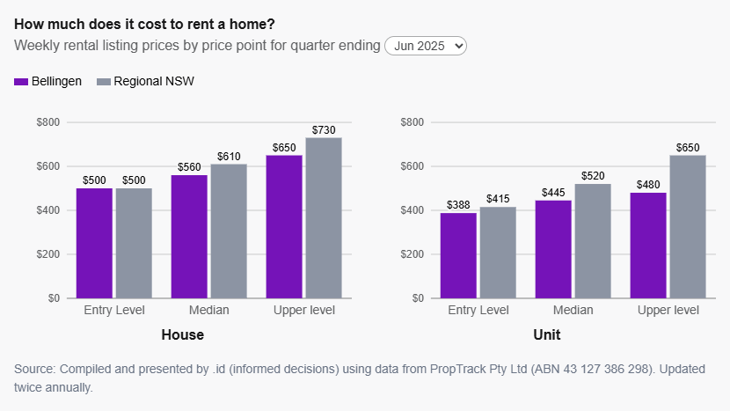
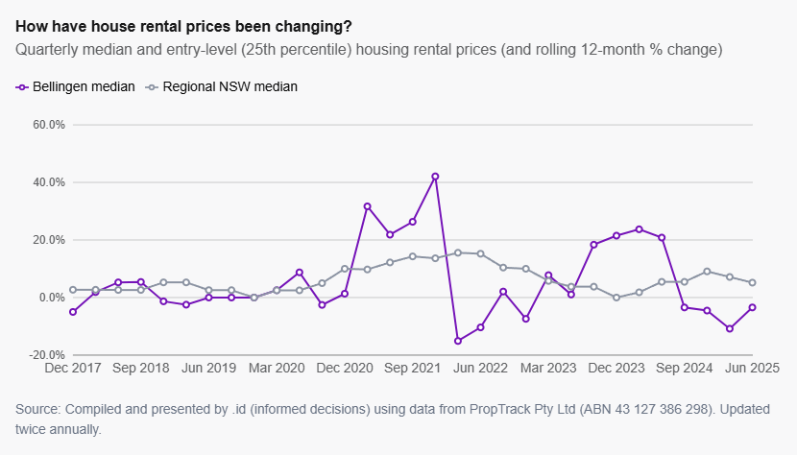
Rental Prices
Rental prices continue to increase despite recent easing in house prices.
A small and constrained rental market leaves little capacity to absorb shocks, limiting options for local residents.
HOUSING COSTS
Source: Housing.id – Bellingen Shire Housing Monitor (ABS Census 2021).

Slide 12
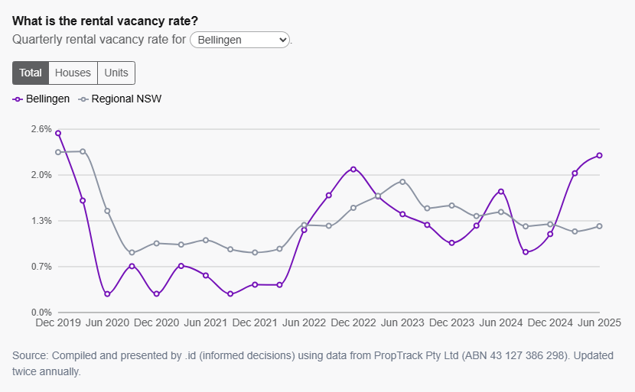
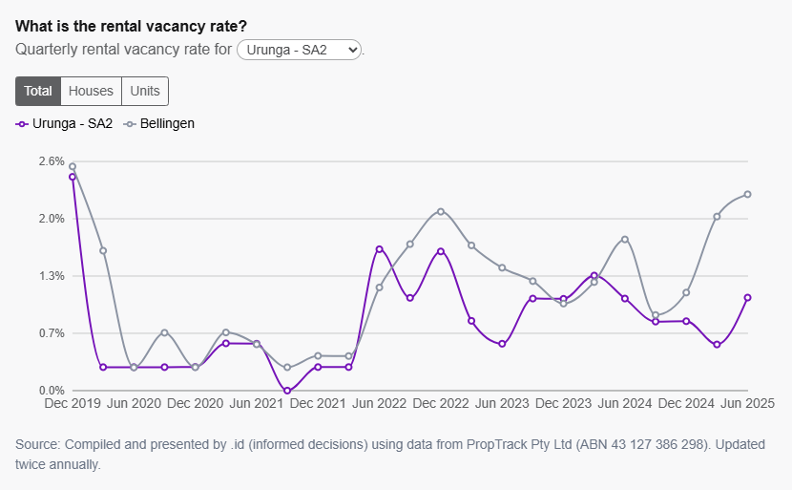
Rental vacancy rates
Rental Vacancy Rates (Bellingen Shire)
Bellingen Shire: 2.23%
Bellingen: 2.45%
Dorrigo: 4.84%
Urunga: 1.06%
Tight vacancy rates indicate a highly constrained rental market, where even small shifts in supply can leave renters with few options and increased housing insecurity.
Source: Housing.id – Bellingen Shire Housing Monitor (ABS Census 2021).
HOUSING COSTS

Slide 13
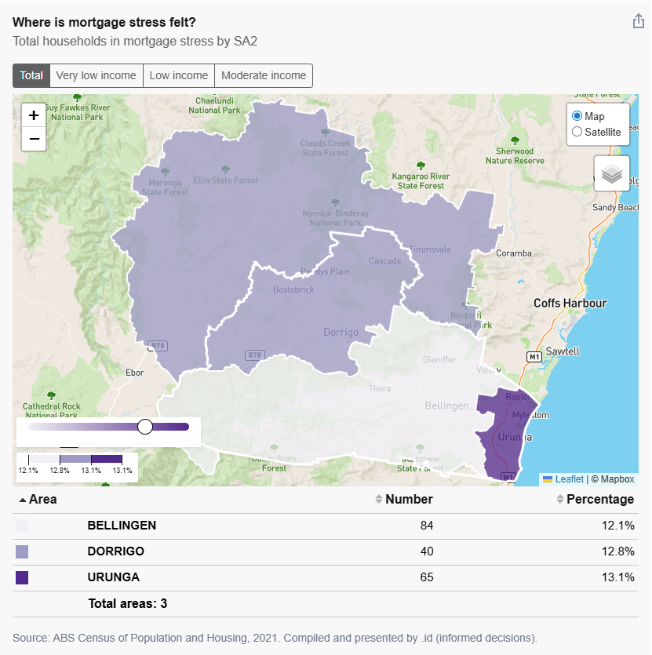
Mortgage Stress
Mortgage Stress Rates
Regional NSW: 8.4%
Bellingen Shire: 12%
Mortgage stress is notably higher in Bellingen Shire than the regional NSW average. For very low- and low-income households, the pressure is significantly greater, indicating that many local residents are carrying housing costs that are difficult to sustain.
Source: Housing.id – Bellingen Shire Housing Monitor (ABS Census 2021).
HOUSING COSTS
Notes:
Very Low Incomes:
Bellingen 61.5%
Dorrigo 81.1%
Urunga 37.5%
Low Incomes:
Bellingen 25.4%
Dorrigo 10.3%
Urunga 35.7%

Slide 14
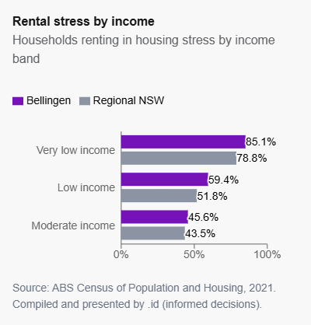
Rental Stress
Bellingen Shire
Rental stress occurs when lower-income households spend more than 30% of their income on rent.
36.3% of private renter households are in rental stress (paying more than 30% of income on rent).
This represents 388 households out of 1,078 private renter households in the Shire.
The rate of rental stress in Bellingen Shire is higher than the Regional NSW average.
Rental stress disproportionately affects very low- and low-income households, who are most exposed to rent increases and market shocks.
Source: Housing.id – Bellingen Shire Housing Monitor (ABS Census 2021).
HOUSING COSTS
Notes:
Rental stress:
Bellingen 36.3%
Regional NSW 28.1%
Of the 1078 households in private rentals in Bellingen Shire, 388 (36.3%) are in rental stress.

Slide 15
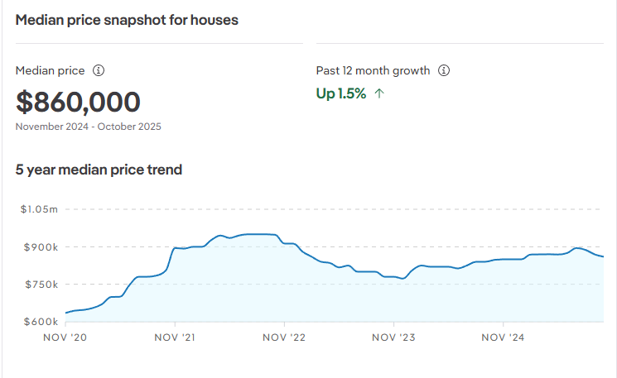
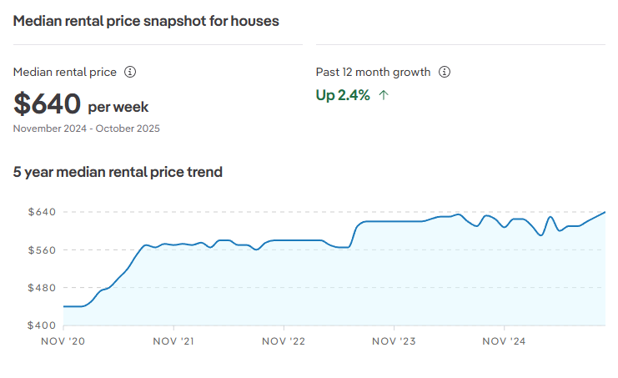
Bellingen Township: Suburb Profile
Housing costs are rising faster than local incomes across the Bellingen township, placing increasing pressure on renters and first-home buyers.
Median house prices increased by 36.5% over the past five years.
Median rents increased by 45.5% over the same period.
Median unit rents increased by 17.3% in the past 12 months, reaching $492 per week.
Source: Bellingen Property Market, House Prices, Investment Data & Suburb Profiles - realestate.com.au
MARKET DATA - Bellingen

Slide 16
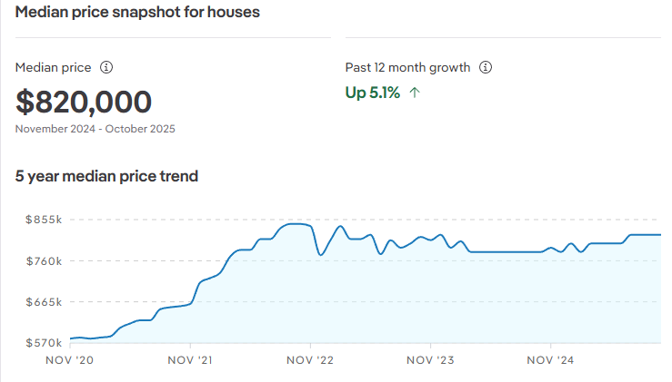
Urunga: Suburb Profile
Urunga has experienced significant growth in both house prices and rents.
Urunga has experienced significant growth in both house prices and rents.
Median house prices increased by 41.3% over the past five years.
Median rents increased by 8.9% over the past 12 months.
Median unit rents increased by 17.3% in the past year, reaching $492 per week.
Source: Urunga Property Market, House Prices, Investment Data & Suburb Profiles - realestate.com.au
MARKET DATA - Urunga

Slide 17
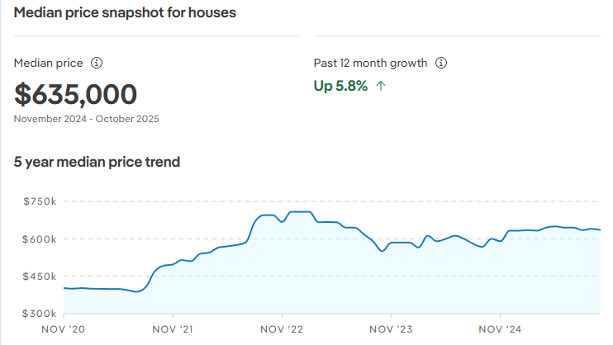
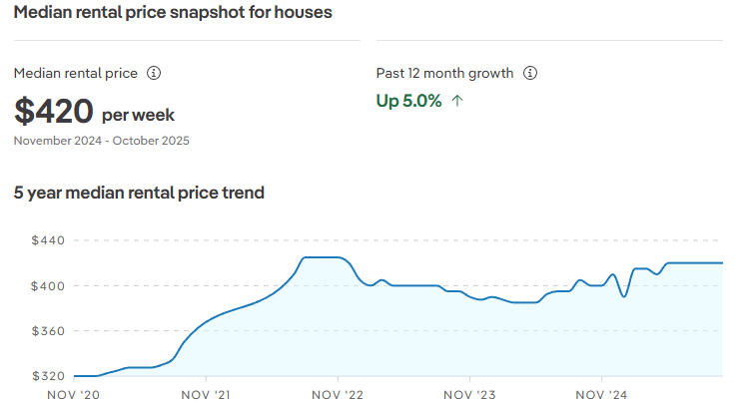
Dorrigo: Suburb Profile
Housing costs in Dorrigo have increased significantly in recent years.
Median house prices increased by 57.7% over the past five years.
Median rents increased by 31% over the same five-year period.
Source: Dorrigo Property Market, House Prices, Investment Data & Suburb Profiles - realestate.com.au
MARKET DATA - Dorrigo

