Slide 1

Housing Needs in the Bellingen Shire
Headlines and Trends from the Needs Mapping 2022 project
This project was partly funded by the Bellingen Shire Council Ring of Resilience initiative
which is a Bushfire Local Economic Recovery Fund project funded through the joint
Commonwealth/State Disaster Recovery Funding Arrangements. Although funding for
this product has been provided by both the Australian and NSW Governments, the material
contained and produced by HMAG does not necessarily represent the views of either government.
Notes:
Some will remember that we did an initial needs mapping following our first Housing Forum in 2018.
We had groundswell of community momentum following the forum and had obviously 'hit a nerve'. We had a lot of survey responses and combined it with statistical data such as ABS and some NSW govt data. That directly influenced our work program for following years – our focus on secure housing for single women over 55 is one such example.
The world has changed a lot since 2018 and so it's time for an update and check in... we'll keep exploring this data but these are our initial headlines and trends...

Slide 2

What information did we use?
Housing Needs Survey
  Individual surveys x 119
  In-depth case study interviews x 3
  Follow up interviews x 2
Workforce Impact Survey
  Local employer surveys x 18
  Follow up discussions x
Housing Statistics / Demographic Information
  ID Solutions – Community and Housing Profiles
  ABS Census data
  Inside AirBNB (specific tool that use data from AirBNB website
  Bellingen Shire Council Local Housing Strategy documents
Media / Anecdotal / Resources from other areas
  While not specifically measured, this information informed some of our thinking and approaches

Slide 3

Case studies…
Following from the initial surveys we identified a small number of in-depth case studies. These conversations provided greater insight into the lived experience and housing priorities of the individual households. While with more time and resources we would have conducted additional interviews, the information we gathered from the small number has provided valuable insights. It was clear that housing security and stability was one of the biggest concerns. Whether it was through home ownership (seen as an unachievable goal by many) or private rentals with long term leases (5+ years), the sense of security was seen as a vital foundation to build community connections, including education, employment, informal support networks and sense of belonging.
Who did we talk with?
Single parent household
Young family
Aboriginal &/or Torres Strait Islanders (generalised)
Who was missing?
Older people
Young people
People with disabilities
Non-citizen residents
Notes:
Rose and I are currently working on some de-identified case studies to provide some greater human depth to the data.
These are semi structured conversations and will be de-identified and possibly combined to ensure privacy.
We have some people in mind but if you or you know people that would be good to talk to, please let us know.
It certainly doesn't need to be a hardship competition – these are about providing insight into what are likely to be relatively common lived experiences as well as the complexity being faced.

Slide 4

Context
Stress along the housing continuum
Mortgage stress, rental stress, homelessness & couch surfing, insecure accommodation etc.
Tough choices – staying in unsafe situations, renting via AirBNB because need money
Not equating lived experiences
The local housing crisis is impacting folks all along the housing spectrum
Notes:
Going on from previous point – we also want to acknowledge the context of this data and the experiences being described.
COVID quote – We might all be in the same storm but not necessarily all in the same boat.
Similarly the housing crisis is impacting people along the housing continuum and in a variety of ways. We are not equating lived experiences. We do not want to diminish nor glorify hardships being faced.
Also recognise that this is a complex area and people can be faced with a selection of unfavourable options

Slide 5

Who answered...
Mostly women
Bellingen centric
Mostly longer terms residents (10+ years)
Mostly people in current accommodation for 3+ years
Equal rates: single person, couple, family
Renters / Informal tenancies / With mortgages / Without mortgages / Homeless / Other...
Notes:
Looking at the Housing Needs individual surveys...
It was mostly women responding (77%)
It was Bellingen centric (42%)
There were a range of ages: 20% 35-44 / 19% 45-54 / 29% 55-64
Fairly even rates of single people living alone, couples living without children, couples living with children
Although this did skew after activities in Dorrigo – previous to that meeting, it was more younger age brackets and people with children, including single parents
Also, if we exclude those owning without a mortgage – different pictures emerge...
Much higher rates of couples and singles living with kids, single people, rates of housing stress etc.
Something we'll explore more.

Slide 6
What's happening

Slide 7
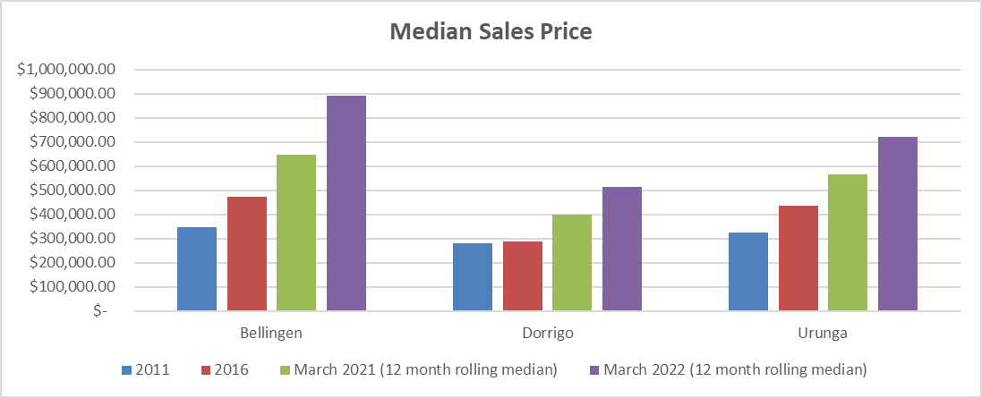
Prices have jumped...
Represents a 12 month increase rather than 5 year
Notes:
This won't be news to anyone – prices have jumped.
Here we can see Bellingen, Dorrigo and Urunga. If we look closer, we can see that the first 3 bars for each township are 5 year intervals – the gap between the green and purple bars however is 12 months...
There's also quite a disparity between Bellingen Shire and Regional NSW averages

Slide 8
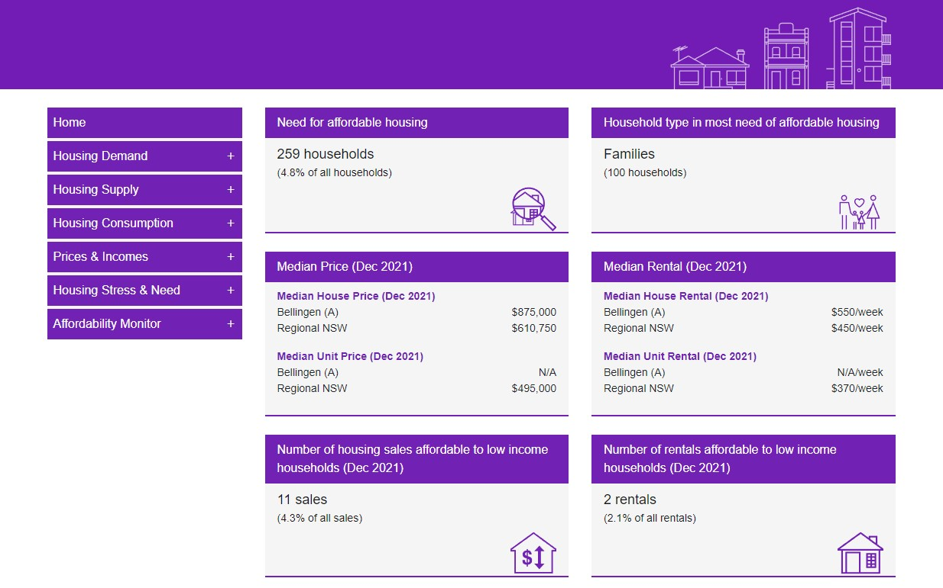
Housing Profile i.d.
Bellingen Shire | housing monitor (id.com.au)
Notes:
We've got access to new data...
Bellingen council has paid to add the Housing Profile module to the Community Profile I.d. - this uses mostly ABS data and is really useful when writing grants or doing this kind of research. We haven't had access for very long and it will be really interesting and useful when more of the Census 21 data is released.
Show dashboard, supply, housing stress, …
Also have inside AirBNB site which we can look at shortly

Slide 9

Supply
Unhealthy homes – approx. 42% said their homes are either mouldy, or have inadequate thermal comfort and/or insulation. This is a significant issue that impacts health, wellbeing and energy bills.
A further 30% live in poorly maintained dwellings with issues such as water damage and poor wiring.
There’s a mismatch b/w dwellings & household’s changing needs – 23% of dwellings too small for growing family, whilst approx. 27% say their dwelling is too large and otherwise inappropriate.
Good news… we have seen an uptick in the construction of smaller dwellings across the Shire b/w 2011-16.

Slide 10
Quick headlines...
Higher rates of housing stress – along the continuum
2018: 27% 2022: 51%
More families responding
2018: Biggest group was 55-64
2022: More spread across groups
Widespread impacts on people's lives
Health & wellbeing | Impact of COVID | Natural hazards |No or inadequate insurance
Renters responding in high numbers
59% renters in financial stress
Notes:
Much higher rate of housing stress being self identified and wider range of respondents age wide
It's also worth mentioning that there were a few spikes in responses that have skewed data. After Dorrigo meeting for example, there was an increase in people without mortgages responding.
It's good to include them as overall picture – and they may still have unmet housing needs - it does change some of the data. And if I exclude the 36 respondents without mortgages – much more dire picture.
New questions about health & wellbeing impacts, COVID, natural disasters and insurance – not much good news in any of those areas but good that we're collecting data about it.

Slide 11
Renters

Slide 12


Renters...
Approx. 21% of Shire residents are renters, which is lower than the state average
Renters are over-represented (40%) as respondents to our housing needs survey
Approx. 25% of renters have an informal rental agreement, this tenure type can create an added layer of vulnerability or precarity
For instance, these respondents indicated they have very short tenancy arrangements of between 1-6 months i.e. accelerated ‘Bellingen Shuffle?’
A further 10% are either homeless or ‘other’, including folks still homeless after recent floods
Most significantly, rental stress has increased dramatically – see next slide:
Notes:
We have a smaller than average percentage of rental houses for Regional NSW but a higher rate of respondents – likely because it's a tough time to be a renter.
High rate of informal tenancies – likely that we're not even scratching the surface – if we take into account how many people are living in unapproved dwellings, have van or cabin set ups, etc.
High rate of people indicating they're homeless

Slide 13
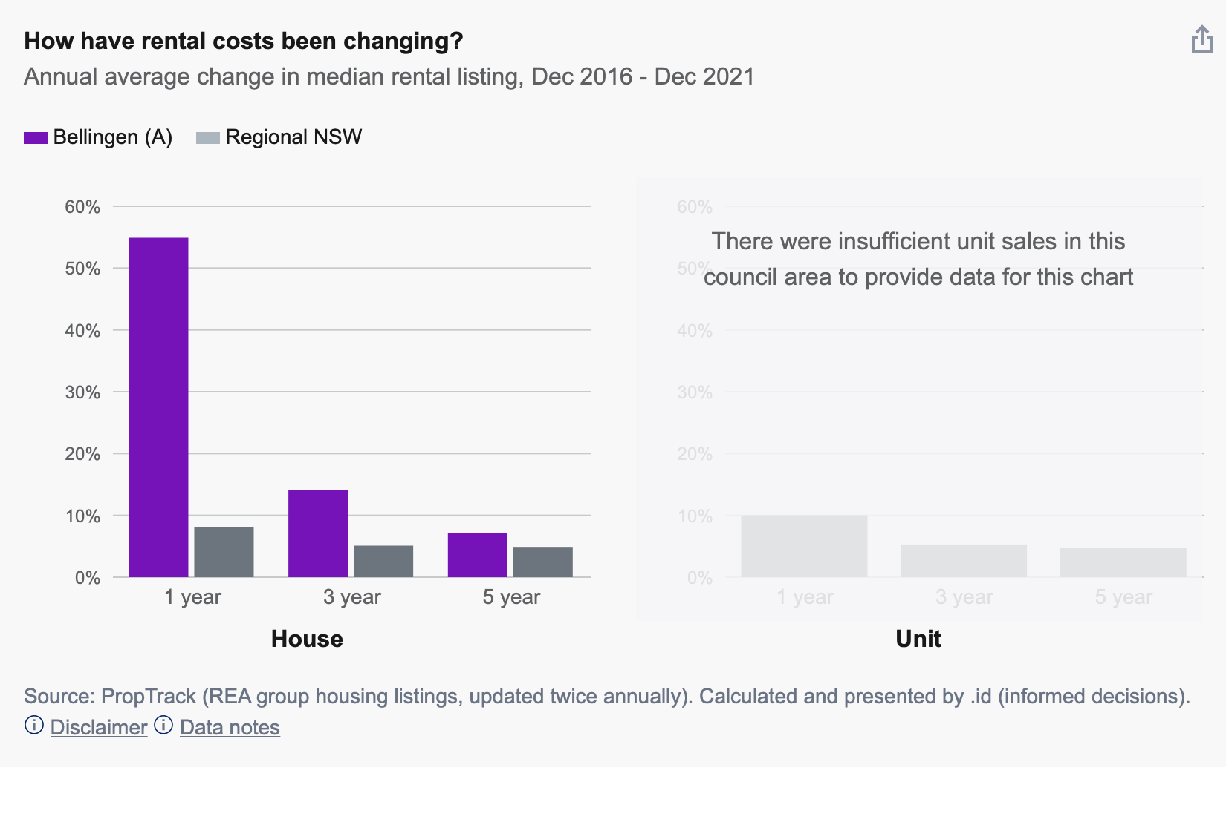
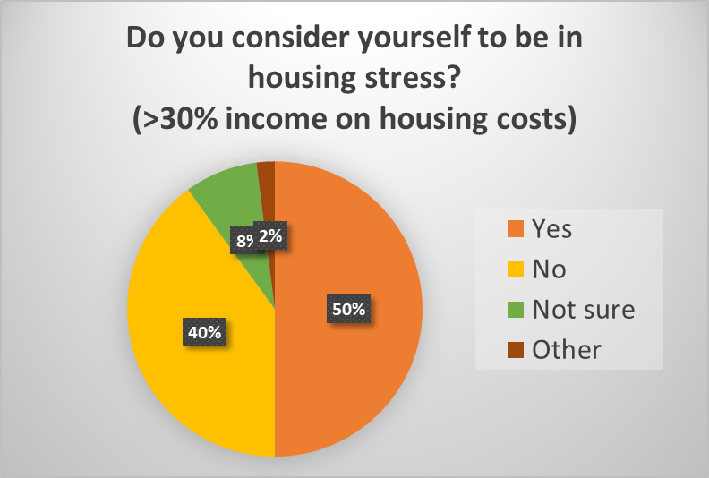
The cost of renting...
Average rent is now $550pw
When asked about the impact of high housing costs, the responses from renters were:
It impacts on my mental health and wellbeing (81%)
I cut back on other essentials like food and healthcare (79%)
I draw on my super or other savings (58%)
I worry about falling behind on my rent (48%)
I rely on assistance from community services and/or local charities like food bank (35%)
It impacts on my ability to maintain employment in the area (23%)
Notes:
Apart from the financial cost – which is now an average of $550 per week – there's also the other costs of renting – the impact on other aspects of lives.
81% say it impacts on mental health and wellbeing
79% are cutting back on essentials like food and healthcare
58% are drawing on super or other savings
48% are worrying about falling behind on their rent
35% are regularly relying on charities like food bank
And 23% say it's impacting on ability to maintain employment in the area
Anecdotally – signs in café for barista's to be able to stay in area / real estate agent said that trades have offered to always prioritise agent requests if they can help with securing rental
We can also see this graph from Housing Profile – the purple is Bellingen and grey is Regional NSW and we can see there's been a 55% increase in rents in 12 months.

Slide 14

The Bellingen Shuffle...
“We have moved every year since we moved here in 2012.”
“House is being sold. We thought this day would come and were planning to buy but prices have escaped our reach. It's terrifying.”
“I couldn't get a rental if I tried. Living in a van on my in-laws property with minimal income due to covid destroying my business. There have been a few I've looked at but I wasn't even considered.”
“I have been subject to unrealistic rental increases and difficult landlord agents. Definitely stressful. I grew up here and returned 5 years ago and it’s gotten worse every year.”
“ Prior to buying I was forced to move every 6 months for 3 years.”
*Refers to a series of short to medium term rentals often 'shuffling' through the small number of rental properties in the area.
Notes:
These are just some of the quotes -

Slide 15

“I have no bargaining power…”
Approx. 78% of renting respondents are anxious about negotiating with their real estate agent/ landlord:
“ We don't raise any issues with our landlord or estate agent because we know we have no power. The rent hikes are killing us.”
“I try not asking for anything!”
“ We have rented for 15-years and it is a constant stress.”
Notes:
And also we're seeing that people aren't asking or feel anxious about asking anything from their landlords or real estate agents. And when we look at the responses to issues around mould, poor maintenance etc – we're seeing that people are putting up with
Incredible power imbalance and this flows through to people putting up with inappropriate and inadequate housing because it's better than the alternative

Slide 16
AirBNB
Notes:
We can't talk about rentals or the housing crisis without mentioning AirBNB and finally we're starting to get more data so that we can have a more informed conversation

Slide 17
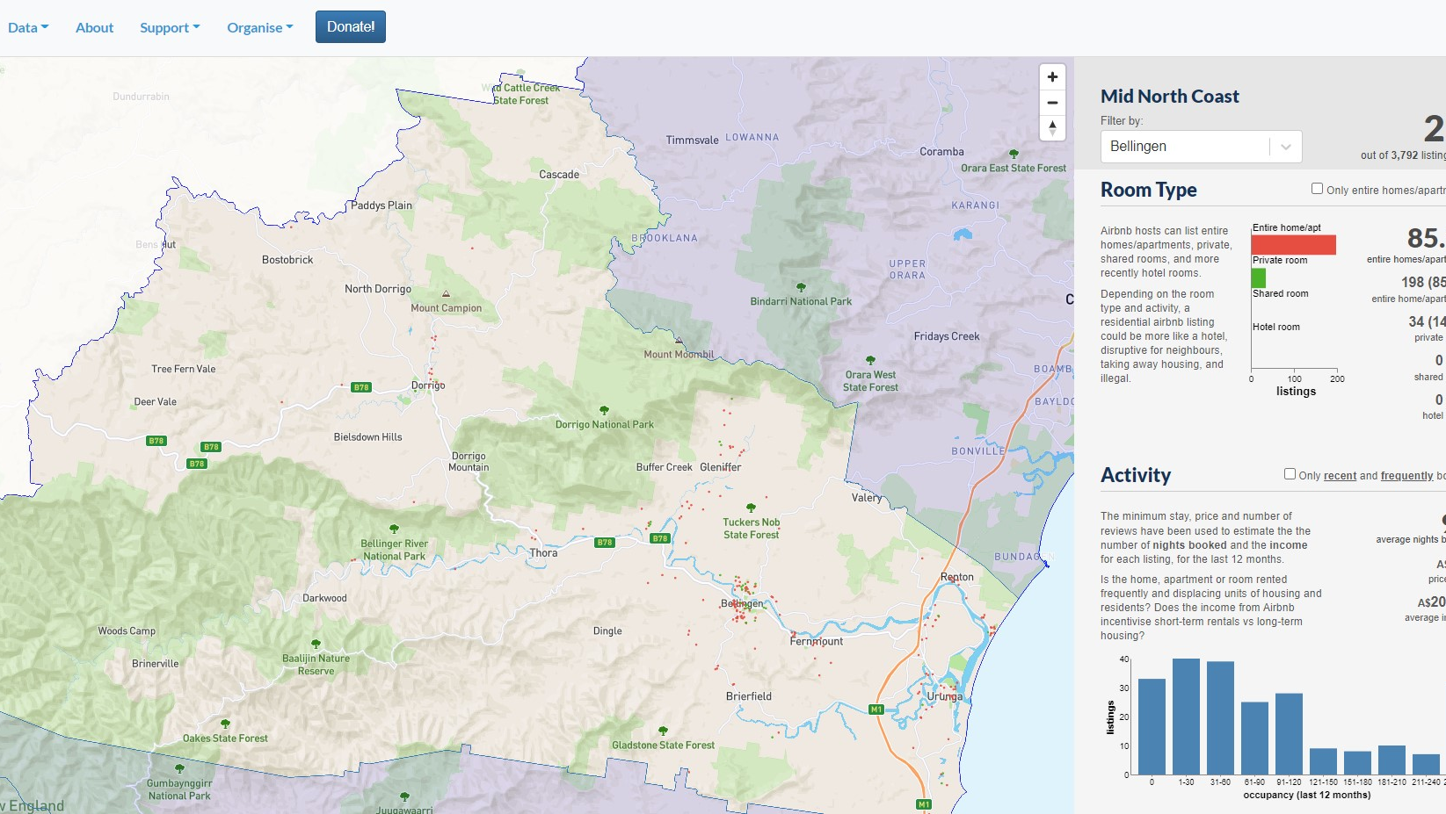

Inside AirBNB – a more informed conversation
232 listings in Bellingen Shire
85.3% are entire home listings
Average price is $280 per night
Average income is $20,212
Average income for 'frequently booked' is $33,611
Inside Airbnb: Mid North Coast
Notes:
This is a tool that has been developed by tech nerds and housing academics after Rose reached out to them. It covers the Mid North Coast so makes it easy to see what's happening across the region and also compare areas.

Slide 18
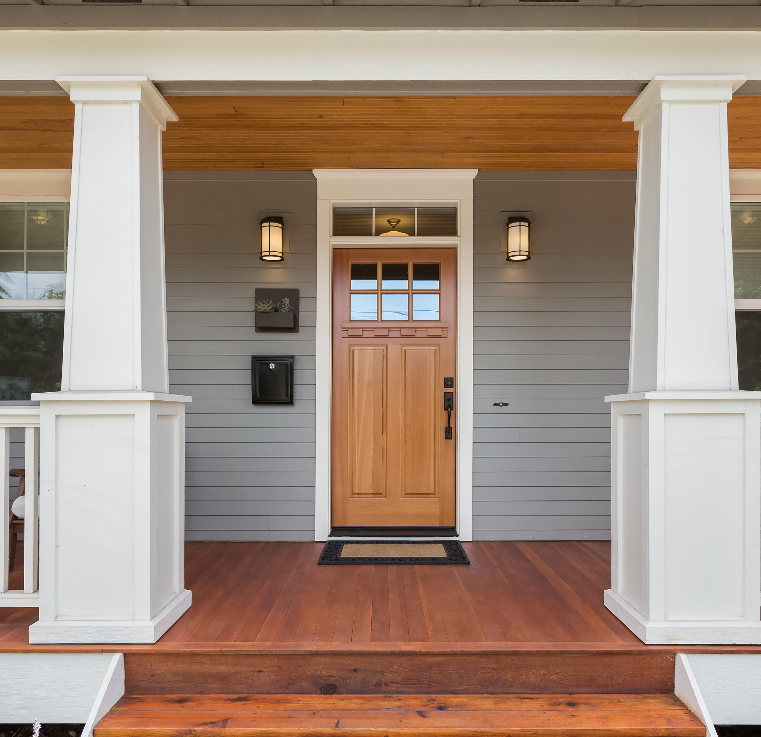
AirBNB - What are we seeing...
Some people are making large annual incomes via AirBNB ($60k+ pa)
For some AirBNB income supplements low local wages / high costs of living and properties
Evidence of properties coming off private rental market to AirBNB
Group of properties booked 255+ nights per year
What are the policy / advocacy platforms that could be developed from a more informed picture of AirBNB?

Slide 19
Housing Impacts on People

Slide 20
Most common issues listed...
Financial stress (rent / mortgage / rates)
Inappropriate structure (unhealthy buildings / poor maintenance)
Lack of stability (lack of secure tenure)

Slide 21
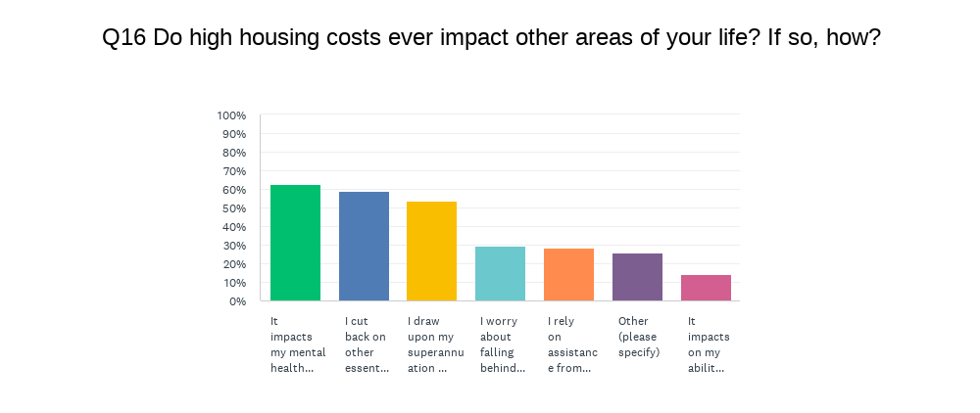
Most common impacts...

Slide 22

Covid, natural hazards, insurance etc…
COVID – impacted on housing related stress (49%), particularly fear of eviction, rent increases, combined with reduced incomes (41%) and changes to household make up (22%)
Natural hazard events – direct impact of floods & storms on properties (32%), indirect impacts (27%), also mention of impact of road closures on ability to work / access medical services etc.
Insurance – Partially insured (13%), no insurance (37%), Unsure (5%)

Slide 23

Workers
Impacts on local economic development

Slide 24
Impact on workforce & local employers
50% have had staff leave directly related to housing issues
54% have had difficultly employing new staff due to lack of available housing
57% believe their employees are likely to be in housing stress
27% have personally had to move due to lack of affordable housing
Notes:
18 Respondents
Mostly long term businesses and services (e.g. 10+ years & includes schools and hospitals)
Good range of industries – reflective of the shire – retail, health care, social assistance, accommodation, hospitality, education,
When asked to estimate the percentage of wages spent on housing for their employees – the average was 45%
When asked about the impact of housing costs on their own lives: (remembering that this is business owners and managers)
Impacts my mental health & wellbeing – 50%
Worry about falling behind on rent / mortgage – 36%
Puts a lot of pressure on my business – 21%
Cut back on essentials like food & healthcare – 21%
Impacts on my ability to maintain employment in the area – 21%
Rely on community services / local charities (eg. Food bank) – 14%

Slide 25
Changes linked to in-migration…
Hard to get casual workers - e.g. planting and harvesting
Staff will not be able to stay as they cannot afford the housing
Applicants are more open to moving into the area
Some customers with more disposable income
We will have no staff resulting in the closure of our business
I will fall into poverty. As it is quality of life is poor
People moving here fully cashed up to buy big.
Low-income jobs will not be filled
Notes:
Respondents were asked about the impact on in-migration – both positive and negative – and what impacts they see if the current trends continue.
Quotes:
I have clients constantly looking for cheaper housing as they cannot afford the housing and their rent assistance doesn’t cover the extra costs.
High rents for poor quality housing means low income families go without necessities
No point having customers with disposable income if we cannot find staff to serve them! Additionally we have always worked hard to try to make good food affordable. Rising house costs make it harder for families to afford good food.
Low grade hospital employees like assistant nurses, cleaners, kitchen staff don't earn enough or are casuals and cant accept pay rates and secure accommodation in Bellingen or Coffs Harbour on low incomes
As a teacher I have seen many students suffering through homelessness, unsuitable housing and having to leave the area, heartbreaking…

Slide 26
Suggestions from employers…
Amnesty on unapproved dwellings
Innovative conversions – e.g. railway carriages, shipping containers etc.
Increased rates for lands with multiple unoccupied houses &/or AirBNB properties
Eco / sustainable living – new village with micro-grid, tanks, permaculture etc.
Reforms – negative gearing / STHL legislation / build public housing
Workforce housing as a priority – 77% agreed
Notes:
There were a range of suggestions put forward from local employers about what could be done in relation to housing in the Bellingen Shire.
Some are broader advocacy positions such as reforming negative gearing
Some are localised
Some are complicated!!!
Support for workforce housing to be a priority focus in the area
Strongly support: 46%
Moderately support: 31%
No one disagreed…
Support for types of housing
Tiny Homes: 62%
Secondary dwellings: 62%
Retrofitting existing dwellings: 62%
Housing co-operatives 54%
Social and community housing: 54%
Innovative models such as CLT: 46%
New development / house & land packages: 46%

Slide 27
Summary
Not great news – especially for renters and those on low to moderate incomes
Some opportunities
Need to find ways to innovative, mobilise and inform the community and broader conversation

Slide 28

Questions to consider…
Does this reflect what we’re seeing?
Are there issues we’ve missed?
How do we use this information?
What are our priorities based on this information?
Did anything else arise for you seeing this?

