Slide 1
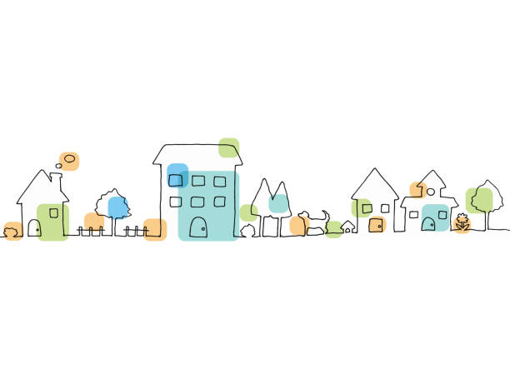

Housing Needs in the Bellingen Shire
Headlines and Trends from the Needs Mapping 2025 project

Slide 2

SECTION 1 — Why This Work Matters
Housing pressures are reshaping who can afford to live and work in the Bellingen Shire.
• Median household income: ~$1,197 per week
• Median rent: ~$492 per week
• Median house price increase: 36–57% over five years
• 61% of renters report repeated moves due to rental instability
Key message:
• The local housing system is increasingly disconnected from local incomes.
• Understanding local experience helps guide practical, community-driven solutions.

Slide 3

What information did we use?
HMAG undertakes a housing needs assessment every 2–3 years — completed in 2018, 2022 and 2025.
We combine:
Housing Needs Mapping Survey
• Long-form survey – 94 responses
• Housing Pulse Survey – 87 responses
Workforce & Sector Input
• Employer outreach (Homes for Health & broader workforce engagement)
• Follow-up conversations with key stakeholders
Housing & Demographic Data
• ABS Census data
• ID Solutions – Community and Housing Profiles
• Housing market data (prices, rents, vacancy rates)
• Bellingen Shire Council housing and planning documents
• Short-term rental data (market sources)
• Policy developments
• Climate and insurance trends

Slide 4

Who Responded in 2025 — and What That Tells Us
Age
• 66% aged 50+
• 34% over 65
Gender
• 85% women
Connection to Place
• 63% lived in the Shire more than 10 years
• Displacement is real and visible (9% wish to return but are living elsewhere)
Tenure
• 44% renters (more than double Census proportion)
• 38% own outright
• 19% mortgage holders
What This Means
• Strong participation from long-term residents
• High engagement from households experiencing rental stress
• Older residents — particularly women — are feeling housing vulnerability

Slide 5
SECTION 2 — Structural Housing Pressure

Slide 6

Market Pressure
Headline: Housing costs have risen much faster than local incomes.
Local household income
• $1,197 per week (Bellingen)
• $1,829 NSW average
Housing prices
• +36–57% over five years
Rents
• +45% over five years
Key takeaway:
• Affordability pressures are structural, not temporary. Many local households
now face a structural affordability gap.
• Housing in the Shire is increasingly shaped by external market forces rather
than local incomes.
Sources:
ABS Census & income data; local market data (realestate.com.au suburb profiles); Local Housing Data Nov 2025; Cotality Housing Affordability Report 2025.

Slide 7
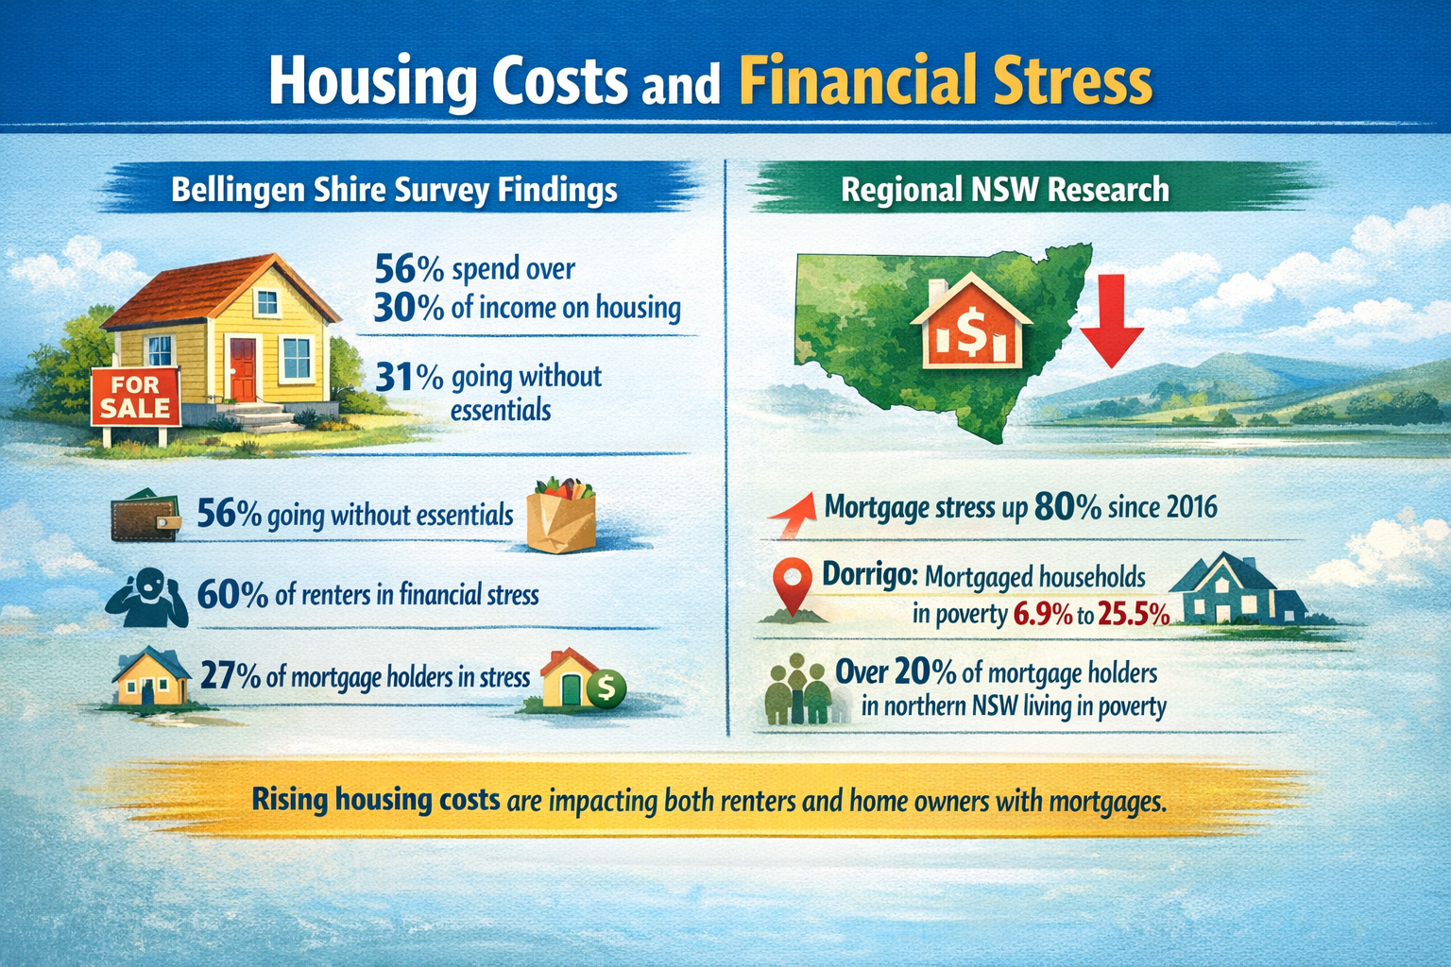
Housing Costs and Financial Stress
Headline: Housing costs are affecting many households, including both renters and mortgagees.
Survey findings:
• 56% spend more than 30% of income on housing
• 31% report going without essentials
• 60% of renters report financial stress
• 27% of mortgage holders report mortgage stress
Regional NSW evidence:
Research commissioned by the NSW Council of Social Services (2023) shows:
• In Dorrigo, poverty rates among households with a mortgage rose from 6.9% to 25.5% over the same period
• Across parts of northern NSW, more than 20% of mortgage holders are living in poverty
Key takeaway:
• Housing stress is no longer limited to renters.
• Rising housing costs, interest rates, and cost-of-living pressures are placing increasing strain on both renters and home-owners with mortgages.

Slide 8
SECTION 3 — What This Means for Renters

Slide 9

Rental Insecurity in the Bellingen Shire
Headline: Rental instability is affecting a growing share of households across the Shire.
Key findings from the HMAG 2025 Needs Mapping Survey:
• 44% of survey respondents were renters — more than double the Census share.
• 40% reported a lack of secure tenure.
• 39% are unsure how long they can remain in their current home.
• 67% worry about interactions with landlords or agents.
• Many avoid requesting repairs due to fear of eviction.
What this means:
• Power imbalance remains a key feature of the rental system.
• Many are experiencing instability and uncertainty about how long they can remain in their homes.
• Their strong engagement highlights that rental insecurity is a widespread issue affecting households across the Shire.
Source: HMAG Needs Mapping Survey 2025.

Slide 10

The “Bellingen Shuffle”
Headline: Frequent forced moves are a defining feature of the local rental market.
Survey finding:
• 61% of renters say the “Bellingen Shuffle” reflects their experience, with many renters moving multiple times within a five-year period.
The “Bellingen Shuffle” describes repeated short-term rental cycles caused by:
• rent increases
• property sales
• owners reclaiming homes
• conversion to short-term accommodation
What this means:
• Many renters move repeatedly within the Shire, often with little notice.
• This creates ongoing disruption for families, children, social connections, employment and schooling.

Slide 11

The Human Impact of Rental Stress
Headline: Housing stress is affecting everyday life for many renters.
Survey responses show:
• 56% cut back on essentials such as food or healthcare
• 56% say housing stress affects their mental health
• 37% say it impacts their family’s wellbeing
• 25% rely on community services or support networks
What this means Housing costs are now affecting:
• health and wellbeing
• family stability
• access to essential services
• financial resilience
• Saving a deposit now takes 10–15 years for many households.
(Cotality Report 2025)
Housing pressure is no longer just a housing issue — it is a public health and wellbeing issue.

Slide 12
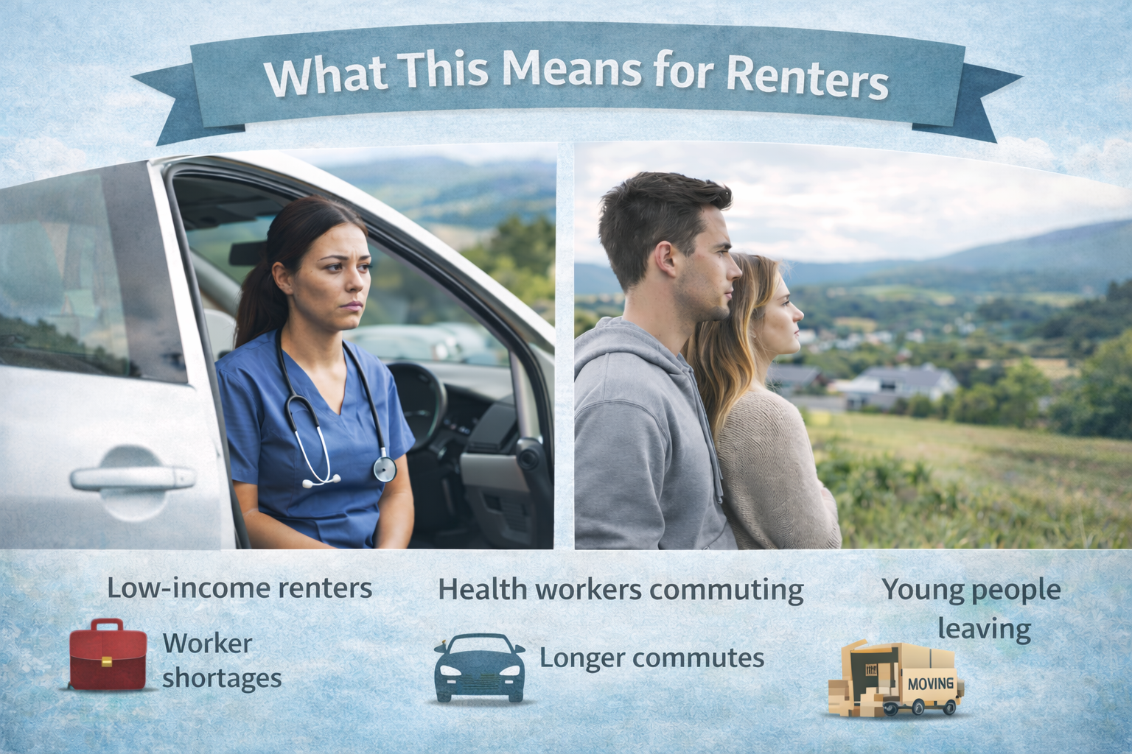
What Rental Stress means for the Local Economy & Community
Headline: Housing access is increasingly shaping the future of the Shire.
It is influencing:
• workforce retention
• local service delivery
• community stability
Housing pressure is creating a cycle of instability:
Rising housing costs → Rental insecurity → Frequent moves and stress → Young people and workers leaving → Community and workforce impacts
Result: Communities across the Shire are increasingly calling for new housing solutions and long-term affordability models.

Slide 13
SECTION 4 — A Community Facing Two Housing Realities

Slide 14
Local Voices: Housing Pressure and Community Concern
Survey respondents (2025)
• Renters: 44%
• Mortgage: 19%
• Own outright: 38%
Bellingen Shire households (Census 2021)
• Renters: ~21%
• Mortgage: ~25%
• Own outright: ~46%
What the comparison suggests
• Renters are over-represented in the survey, reflecting the housing pressures many households face.
• At the same time, many respondents own their homes outright, showing strong engagement from securely housed residents.
• This suggests broad community concern about the wider impacts of the housing crisis on the Shire.
Community voice
Survey responses also show that securely housed residents care deeply about the issue, even when their own housing situation is stable.
“We always say we were lucky. We bought our place years ago and own it outright. But I worry about young people, and the people who make this community work —they’re finding it harder and harder to stay. It really worries me.”
Source: ABS Census 2021; HMAG Housing Needs Survey 2025.

Slide 15
A Changing Housing Market
Cash purchasing in the local housing market
In 2023, Bellingen Shire sat in the top 20% of NSW areas for cash purchases, with:
• 50.4% of residential property purchases made without a mortgage
• Median purchase price around $937,500
Across NSW and Queensland housing markets, a growing share of homes are being purchased outright by buyers with accumulated housing wealth, including retirees or households relocating from higher-priced housing markets. Because these buyers do not rely on mortgages, they can compete strongly in regional markets where local incomes may not support similar purchase prices.
What this suggests
These dynamics point to increasing stratification in the housing system.
The market is increasingly shaped by two groups:
• households entering the market with accumulated housing wealth and cash purchasing power
• households relying on local wages, mortgages or rental housing
This dynamic can intensify competition for housing and influence who is able to enter or remain in the local housing market.
Source: ABS Census 2021; HMAG Housing Needs Survey 2025; PEXA / ABC News reporting on cash property purchases (2023).

Slide 16
SECTION 5 — Housing Resilience and Future Risks

Slide 17
Housing Supply Does Not Match Household Needs
Across HMAG’s 2018, 2023 and 2025 surveys, residents consistently identified a mismatch between available housing and local household needs — a pattern that emerges strongly again in the 2025 responses.
Common themes raised by respondents:
• Too many large detached homes relative to household size
• A shortage of smaller, modest and more affordable dwellings
• Limited downsizing options for older residents wishing to stay locally (a large and growing share of the Shire’s population).
• Few entry-level homes for younger households and first-time buyers
As one respondent noted: “We don’t need more big houses — we need smaller, simpler homes that local people can actually afford.”
Another resident wrote: “There’s nowhere for older residents to downsize without leaving the community.”
What this Means?
• Household structures are changing — with more single people, smaller households and ageing residents — but the housing system has not adapted to these demographic shifts.
• This structural mismatch continues to place pressure on both younger households trying to enter the market and older residents looking to transition to more suitable housing.
• An ageing population and limited downsizing options mean many older residents remain in large homes, reducing housing turnover and limiting availability for families.

Slide 18
Climate Risk and Housing Security
HMAG first introduced questions on climate impacts and housing resilience in 2023, and the 2025 survey shows many of the same concerns emerging again.
Survey findings
• Many households report impacts from floods, storms or extreme heat
• 33% say their housing is not suitable for a changing climate
• Some respondents report reducing or cancelling insurance due to rising premiums
Emerging risks
• Rising insurance costs and under-insurance
• Some properties may become difficult or impossible to insure as climate risks intensify
• Climate risks increasingly shaping housing security and property values
Broader evidence
• Climate Council (2022) warns growing parts of Australia face increasingly unaffordable or unavailable insurance
• Recent national climate risk assessments highlight rising exposure to flooding, storms and sea-level rise
Key insight
• Climate risk is becoming an important long-term housing issue for the Shire.
Sources: HMAG Housing Needs Surveys 2023 & 2025; Climate Council Uninsurable Nation (2022); Australian Government Climate Risk Assessment reporting (ABC News).

Slide 19
SECTION 6 — Community Priorities for Housing

Slide 20
What Residents See as the Biggest Problems
Headline: Residents consistently identified several key drivers of the local housing challenge:
• Housing costs far exceeding local wages
• Short-term rentals reducing long-term rental supply
• Limited diversity of housing types, particularly smaller and affordable homes
• Planning and development constraints limiting appropriate new housing
• Displacement of local residents, especially younger households and workers
Resident voices:
“House prices are seriously out of step with local incomes.”
“Too many homes on Airbnb instead of taking in locals — it’s so competitive.”
“Every time the house we’re renting gets sold we have to start again — packing up, finding somewhere else, and covering the cost of another move.”

Slide 21
What Residents Want to See
Headline: Residents expressed strong support for practical, locally appropriate housing solutions.
Common priorities included:
• More genuinely affordable housing for local workers and families
• Smaller and more diverse housing types, including modest homes and downsizing options
• Greater security and stability for renters
• Stronger management of short-term rentals to protect long-term housing supply
• Innovative housing models, including shared equity, co-housing and community-led approaches
Resident voices:
“Homes are not an asset but a basic human right.”
“Smaller houses and options for older residents.”
“More varied housing, more co-ops, and more public housing stock.”
“People paying high rents should be able to use that towards a mortgage.”

Slide 22
SUMMARY — Key Insights

Slide 23
Key Insights
1. Housing pressure is structural, not temporary
Rising prices, tight rental supply and strong external demand continue to reshape the local housing system.
2. Local incomes are increasingly disconnected from housing costs
Housing prices and rents have grown far faster than wages, making it difficult for locally employed households to secure housing.
3. Rental instability is a defining feature of the current housing system
Many renters experience frequent forced moves, rising costs, and intense competition in a tight rental market with very low vacancy rates.
4. Housing vulnerability spans tenure types
While renters face the greatest instability, mortgage holders and other households are also experiencing growing financial pressure.
5. Housing supply does not match household needs
The housing stock remains dominated by large detached homes, with limited options for smaller households, downsizers and first-home buyers.
6. Climate risk is emerging as a housing security issue
Insurance affordability, exposure to climate hazards and housing resilience are becoming long-term concerns.
7. There is strong community support for new housing approaches
Residents expressed openness to diverse housing types, community-led models and policies that prioritise homes for local people.

